Slide 1
CSBS NHT 101:
New Hire Training for the Conference of State Bank Supervisors

Slide 2
Introduction
This storyboard is a visual representation of the conceptual design for the Conference of State Bank Supervisors’ New Hire Training: NHT 101
This storyboard focuses on Gagne’s Nine Events of Instruction and will use the abbreviations in red throughout:
Gaining attention (G1)
Informing the learner of the objective (G2)
Stimulating recall of prerequisite learned capabilities (G3)
Presenting the stimulus material (G4)
Providing learning guidance (G5)
Eliciting performance (G6)
Providing feedback about performance correctness (G7)
Assessing the performance (G8)
Enhancing retention and transfer (G9)

Slide 3
LMS Home Page
The “Learning Plan”
NOTE: The course is still in DRAFT mode. Not all content has been created. There are many placeholders.

Slide 4
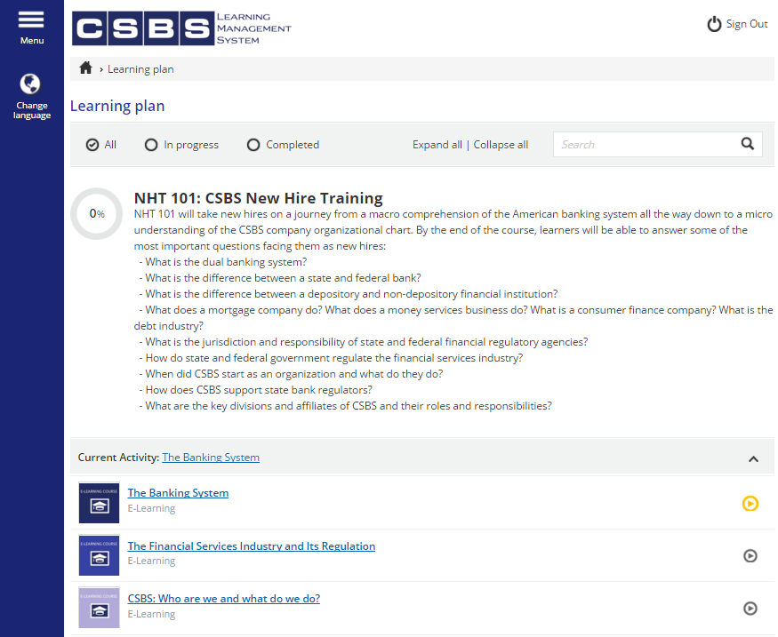
(G1 & G3) Course description and questions gain learner attention and help stimulate recall of prerequisite learned capabilities.
Click
STORY NOTES:
Home page for the NHT 101 course.
This is where students can access all modules week-by-week.

Slide 5
Week 1: Module 1
The Banking System
NOTE: The course is still in DRAFT mode. Not all content has been created. There are many placeholders.

Slide 6
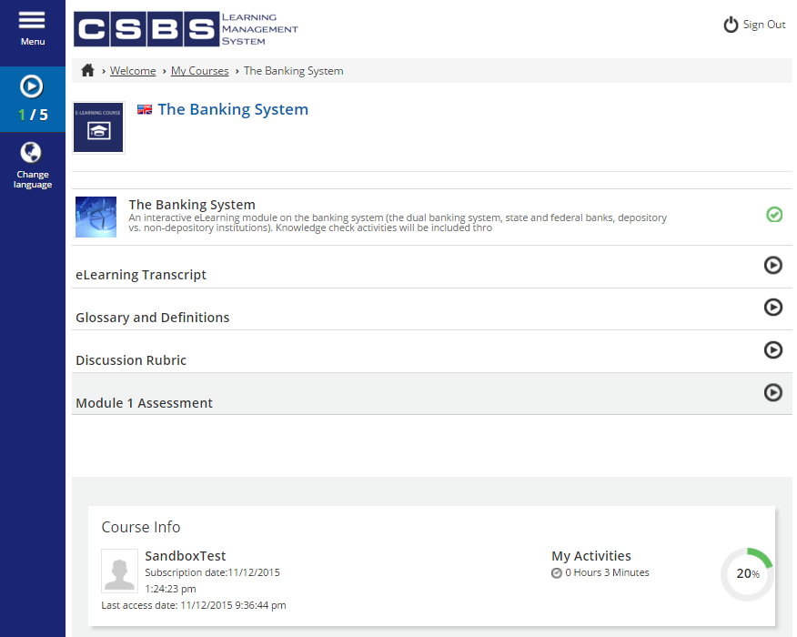
(G4) Presenting the stimulus material and supporting documentation.
(G5) Providing learning guidance by showing course status in dashboard.
STORY NOTES:
This is the top half of the home page for Module 1: The Banking System.

Slide 7
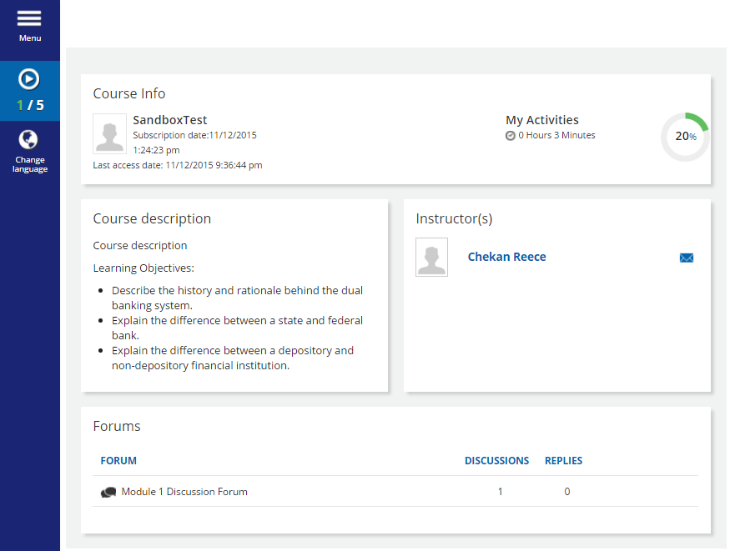
(G2) Objectives are provided on course home page, as well as in the eLearning module above.
(G5 & G7) Direct access to instructor is provided via email for feedback and learning guidance.
STORY NOTES:
This is the bottom half of the home page for Module 1: The Banking System.

Slide 8
Click
STORY NOTES:
Here, there learner would select the first learning object, an eLearning module on the banking system.

Slide 9
(G4) eLearning module presents stimulus material and delivers content in order to teach learning objectives.
STORY NOTES:
This is an example of the look and feel of the eLearning module opening slides.

Slide 10
(G4 & G9) Videos and other interactive media are used to provide alternative learning experiences. This helps to enhance retention and transfer.
STORY NOTES:
This is an example of the eLearning module general content.

Slide 11
(G6, G7, & G8) Knowledge checks and other activities are included throughout the eLearning module to elicit performance, provide feedback, and assess the performance.
STORY NOTES:
This is an example of the knowledge checks built into the eLearning module.

Slide 12
(G4 & G9) Amplifying learning materials are made available to help learners with varying learning styles. This helps to enhance retention and transfer.
Click
STORY NOTES:
After completing the eLearning module, the learner has access to all of the other course materials.

Slide 13
(G5 & G7) Participation in the discussion forum helps to provide learning guidance by relating the course material directly to learners’ jobs. Instructors and SMEs can provide feedback, as well.
STORY NOTES:
At the bottom of the course home page, the learner has access to the Module 1 Discussion Forum.
Click

Slide 14
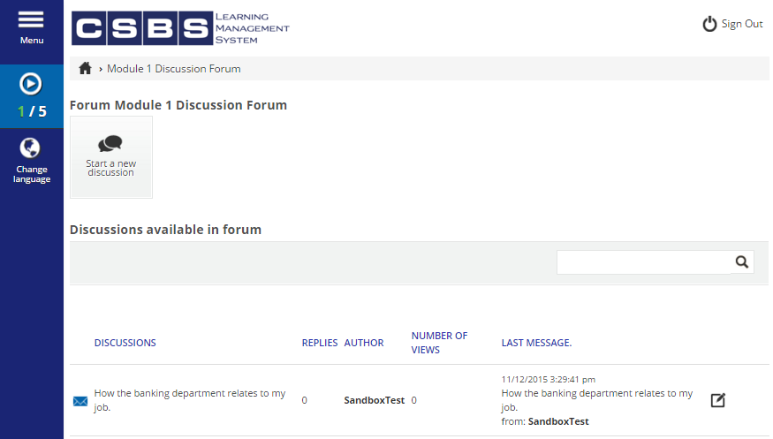
(G5 & G7) Participation in the discussion forum helps to provide learning guidance by relating the course material directly to learners’ jobs. Instructors and SMEs can provide feedback, as well.
Click
STORY NOTES:
This is an example of a discussion forum.

Slide 15
(G6 & G8) The assessment for the module helps the learner and instructor assess the performance and elicits performance from the student.
Click
STORY NOTES:
After contributing to the discussions throughout the week, the learner would then take the Module 1 Assessment.

Slide 16
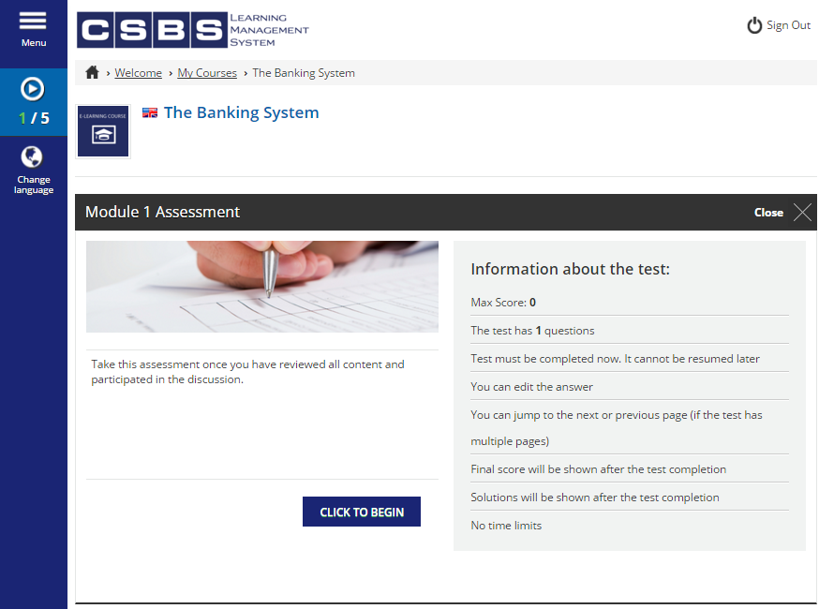
(G6 & G8) The assessment for the module helps the learner and instructor assess the performance and elicits performance from the student.
STORY NOTES:
Here is an example of the homepage for a Module’s assessment functionality.

Slide 17
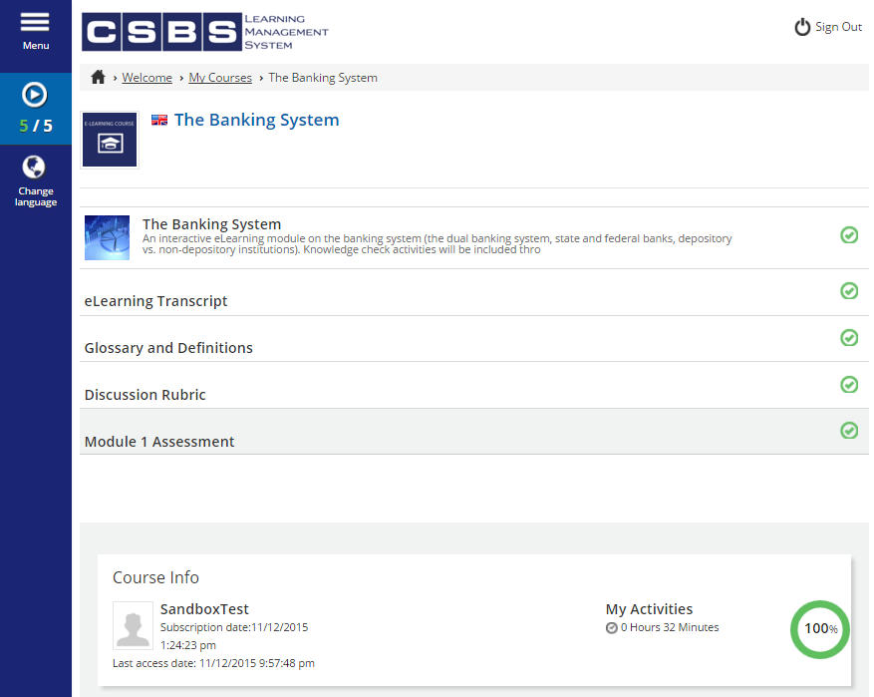
(G7) As the student completes each part of the module, their performance is graded automatically and they are aware of their progress.
STORY NOTES:
After viewing all of the learning items and passing the assessment, the learner has completed Module 1.

Slide 18
Week 2: Module 2
The Financial Services Industry and Its Regulation
NOTE: The course is still in DRAFT mode. Not all content has been created. There are many placeholders.

Slide 19
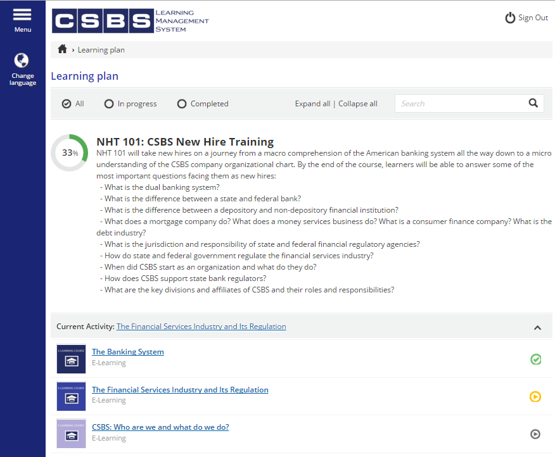
(G1 & G3) Course description and questions gain learner attention and help stimulate recall of prerequisite learned capabilities.
STORY NOTES:
Now that Module 1: The Banking System is complete, the learner can move on to Module 2.
Click

Slide 20
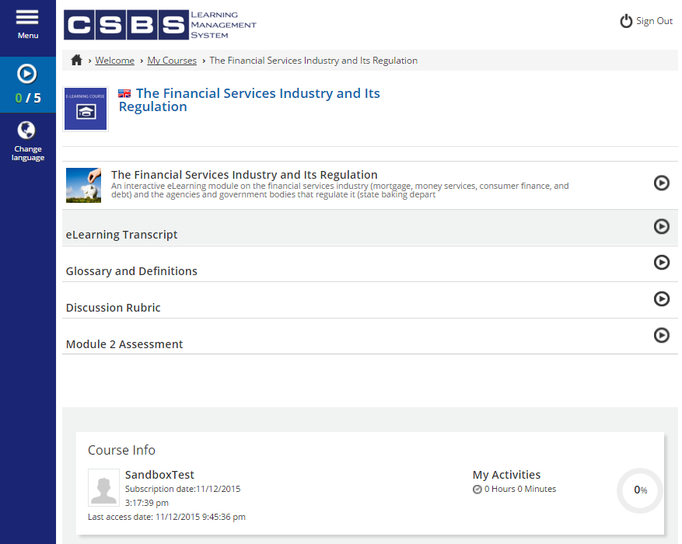
(G4) Presenting the stimulus material and supporting documentation.
(G5) Providing learning guidance by showing course status in dashboard.
STORY NOTES:
This is the top of the home page for Module 2: The Financial Services Industry and Its Regulation.

Slide 21
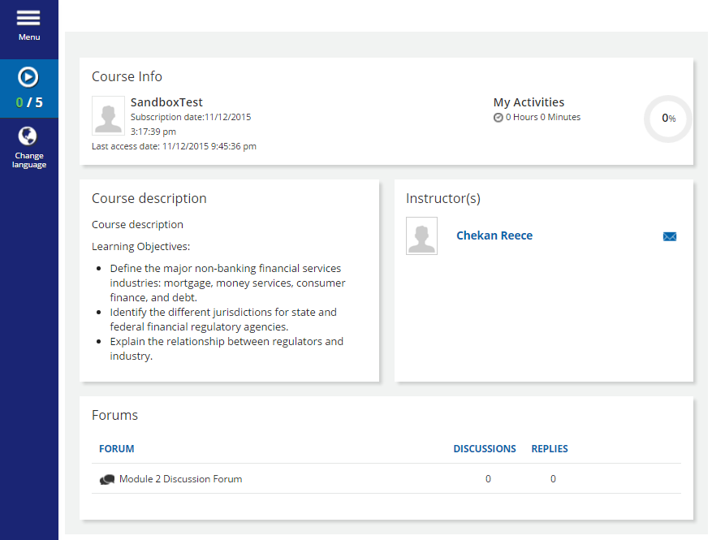
(G2) Objectives are provided on course home page, as well as in the eLearning module above.
(G5 & G7) Direct access to instructor is provided via email for feedback and learning guidance.
STORY NOTES:
This is the bottom of the home page for Module 2.

Slide 22
Click
STORY NOTES:
From here, the learner would first access the eLearning module for Module 2.

Slide 23
(G4) eLearning module presents stimulus material and delivers content in order to teach learning objectives.
STORY NOTES:
This is an example of the look and feel of the eLearning module opening slides.

Slide 24
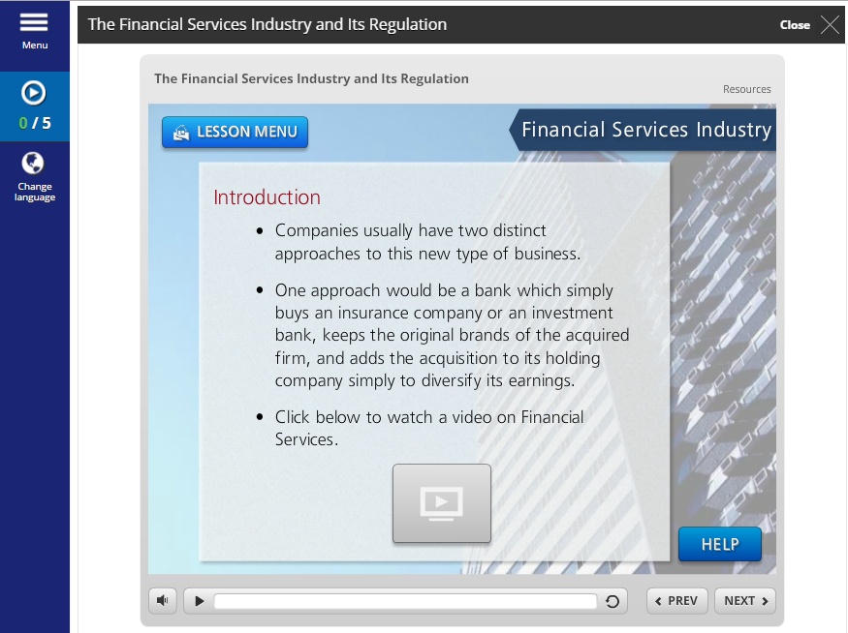
(G4 & G9) Videos and other interactive media are used to provide alternative learning experiences. This helps to enhance retention and transfer.
STORY NOTES:
This is an example of the eLearning module general content.

Slide 25
(G6, G7, & G8) Knowledge checks and other activities are included throughout the eLearning module to elicit performance, provide feedback, and assess the performance.
STORY NOTES:
This is an example of the knowledge checks built into the eLearning module.

Slide 26
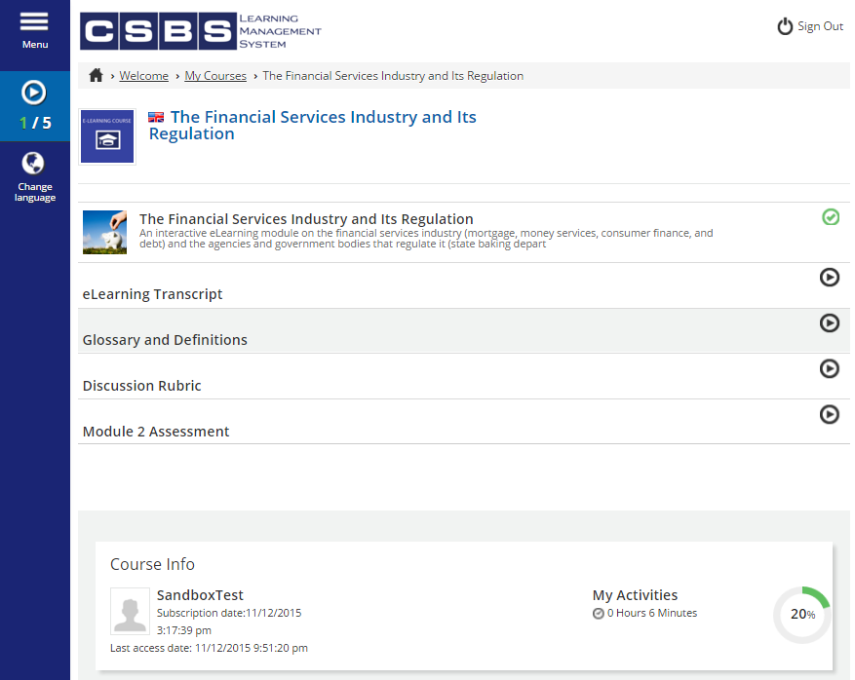
(G4 & G9) Amplifying learning materials are made available to help learners with varying learning styles. This helps to enhance retention and transfer.
Click
STORY NOTES:
After completing the eLearning module, the learner has access to all of the other course materials.

Slide 27
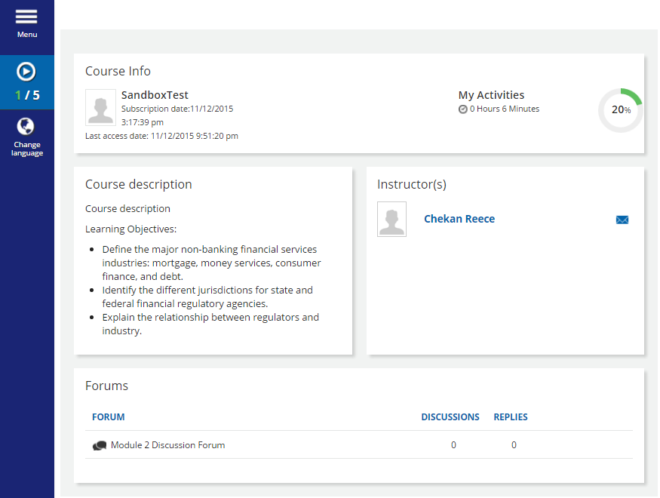
(G5 & G7) Participation in the discussion forum helps to provide learning guidance by relating the course material directly to learners’ jobs. Instructors and SMEs can provide feedback, as well.
STORY NOTES:
At the bottom of the course home page, the learner has access to the Module 2 Discussion Forum.
Click

Slide 28
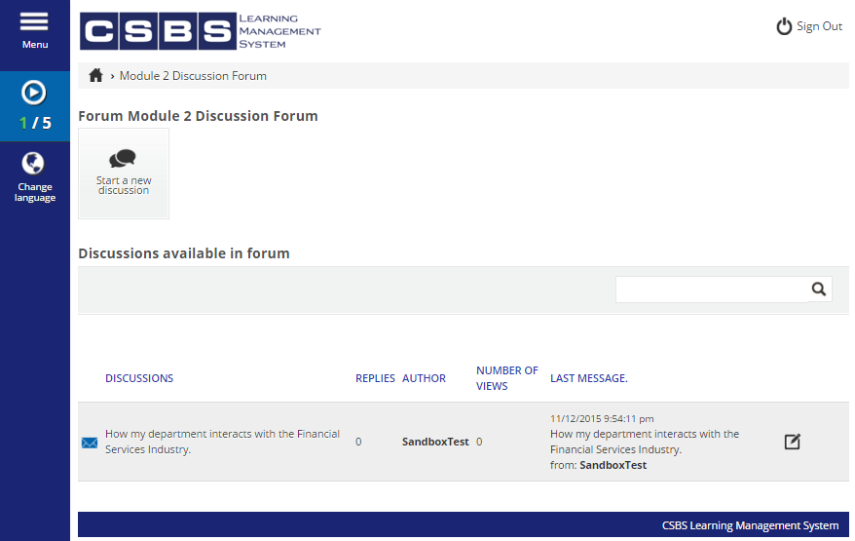
(G5 & G7) Participation in the discussion forum helps to provide learning guidance by relating the course material directly to learners’ jobs. Instructors and SMEs can provide feedback, as well.
Click
STORY NOTES:
This is an example of a discussion forum.

Slide 29
(G6 & G8) The assessment for the module helps the learner and instructor assess the performance and elicits performance from the student.
Click
STORY NOTES:
After contributing to the discussions throughout the week, the learner would then take the Module 2 Assessment.

Slide 30
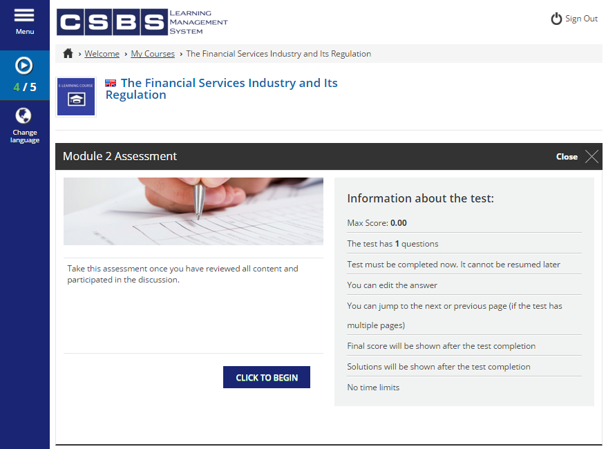
(G6 & G8) The assessment for the module helps the learner and instructor assess the performance and elicits performance from the student.
STORY NOTES:
Here is an example of the homepage for a Module’s assessment functionality.

Slide 31
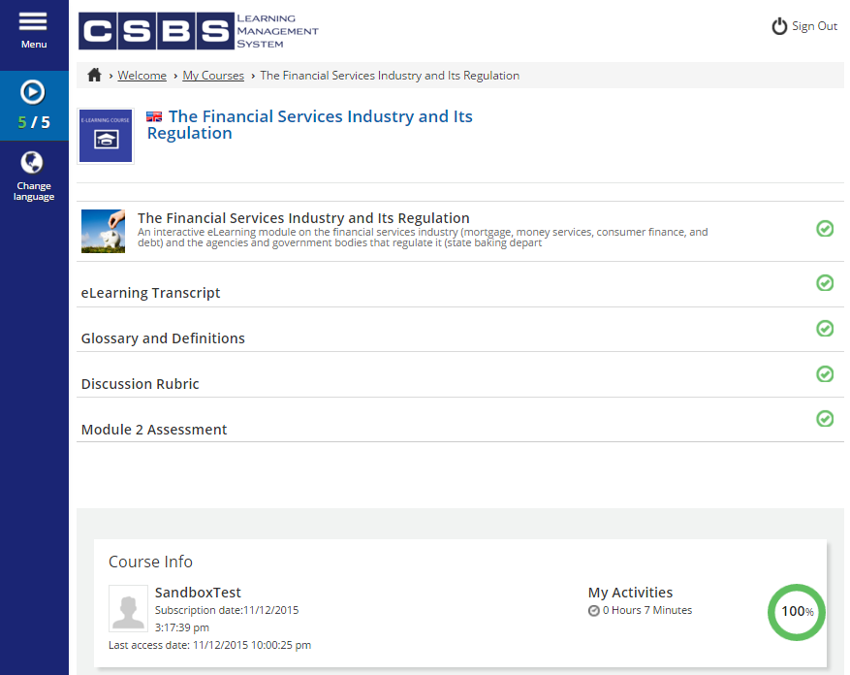
(G7) As the student completes each part of the module, their performance is graded automatically and they are aware of their progress.
STORY NOTES:
After viewing all of the learning items and passing the assessment, the learner has completed Module 2.

Slide 32
Week 3: Module 3
CSBS: Who are we and what do we do?
NOTE: The course is still in DRAFT mode. Not all content has been created. There are many placeholders.

Slide 33
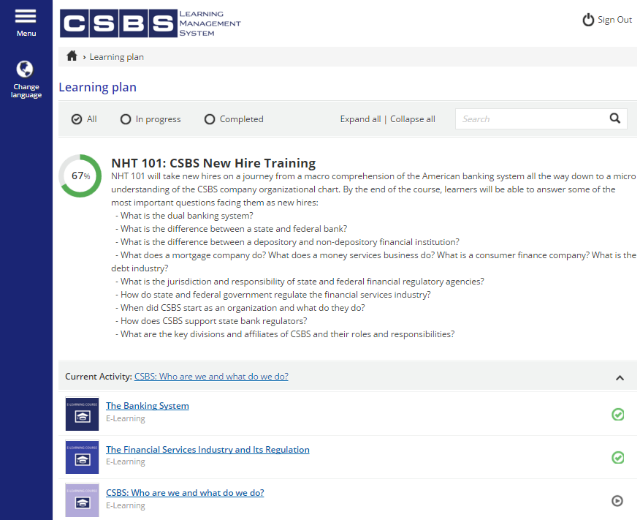
(G1 & G3) Course description and questions gain learner attention and help stimulate recall of prerequisite learned capabilities.
STORY NOTES:
Now that Module 2, the learner can move on to Module 3.
Click

Slide 34
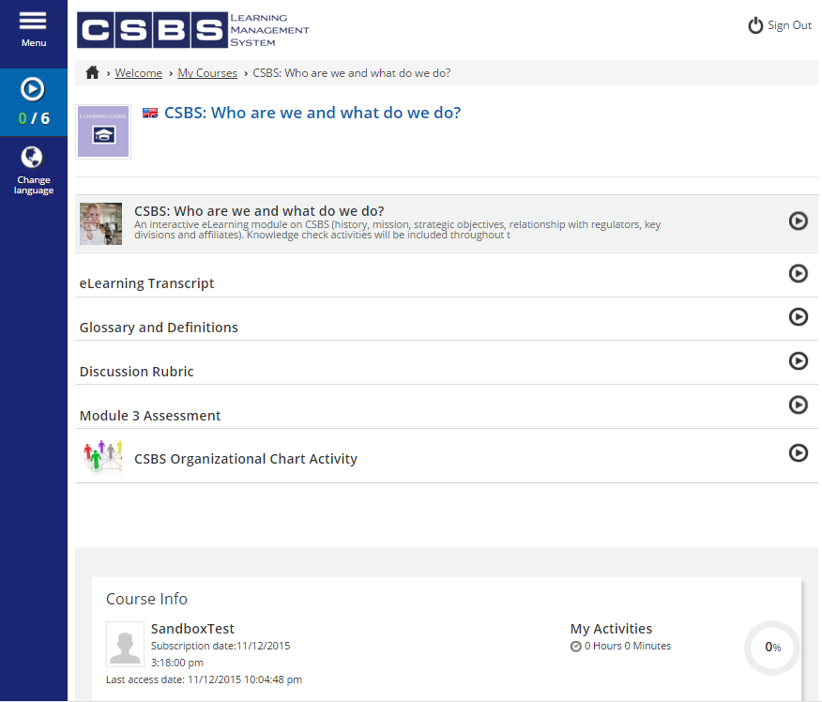
(G4) Presenting the stimulus material and supporting documentation.
(G5) Providing learning guidance by showing course status in dashboard.
STORY NOTES:
This is the top of the home page for Module 3: CSBS: Who are we and what do we do?.

Slide 35
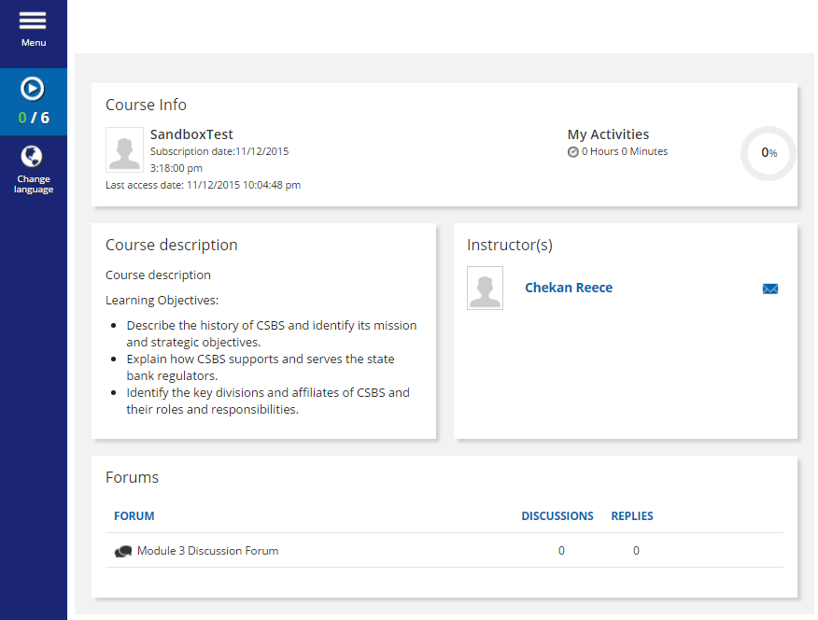
(G2) Objectives are provided on course home page, as well as in the eLearning module above.
(G5 & G7) Direct access to instructor is provided via email for feedback and learning guidance.
STORY NOTES:
This is the bottom of the home page for Module 3.

Slide 36
Click
STORY NOTES:
From here, the learner would first access the eLearning module for Module 3.

Slide 37
(G4) eLearning module presents stimulus material and delivers content in order to teach learning objectives.
STORY NOTES:
This is an example of the look and feel of the eLearning module opening slides.

Slide 38
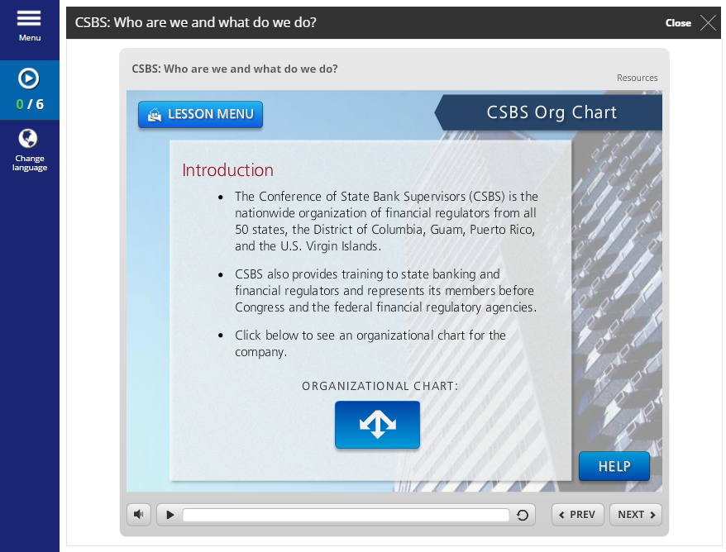
(G4 & G9) Videos and other interactive media are used to provide alternative learning experiences. This helps to enhance retention and transfer.
STORY NOTES:
This is an example of the eLearning module general content.

Slide 39
(G6, G7, & G8) Knowledge checks and other activities are included throughout the eLearning module to elicit performance, provide feedback, and assess the performance.
STORY NOTES:
This is an example of the knowledge checks built into the eLearning module.

Slide 40
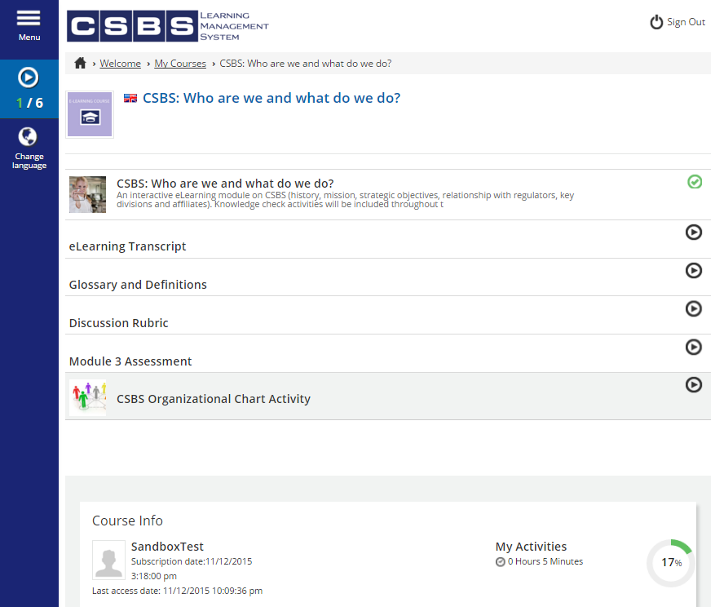
(G4 & G9) Amplifying learning materials are made available to help learners with varying learning styles. This helps to enhance retention and transfer.
Click
STORY NOTES:
After completing the eLearning module, the learner has access to all of the other course materials.

Slide 41
(G5 & G7) Participation in the discussion forum helps to provide learning guidance by relating the course material directly to learners’ jobs. Instructors and SMEs can provide feedback, as well.
Click
STORY NOTES:
At the bottom of the course home page, the learner has access to the Module 3 Discussion Forum.

Slide 42
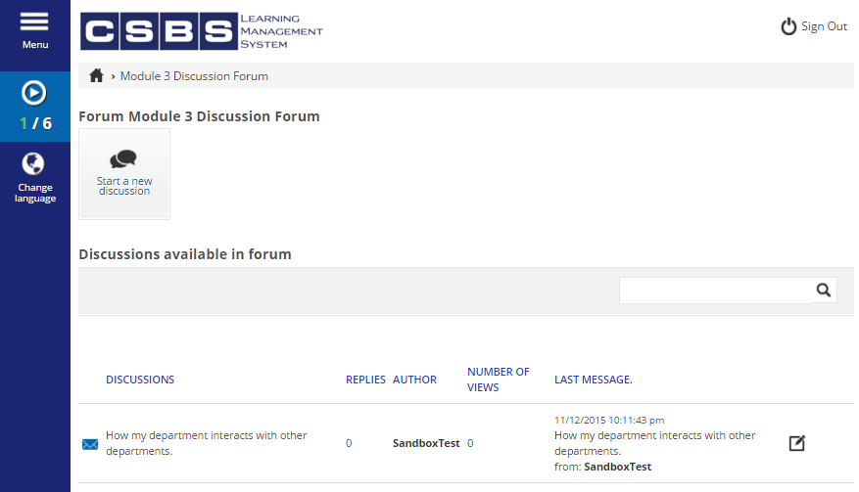
(G5 & G7) Participation in the discussion forum helps to provide learning guidance by relating the course material directly to learners’ jobs. Instructors and SMEs can provide feedback, as well.
Click
STORY NOTES:
This is an example of a discussion forum.

Slide 43
(G6 & G8) The assessment for the module helps the learner and instructor assess the performance and elicits performance from the student.
Click
STORY NOTES:
After contributing to the discussions throughout the week, the learner would then take the Module 3 Assessment.

Slide 44
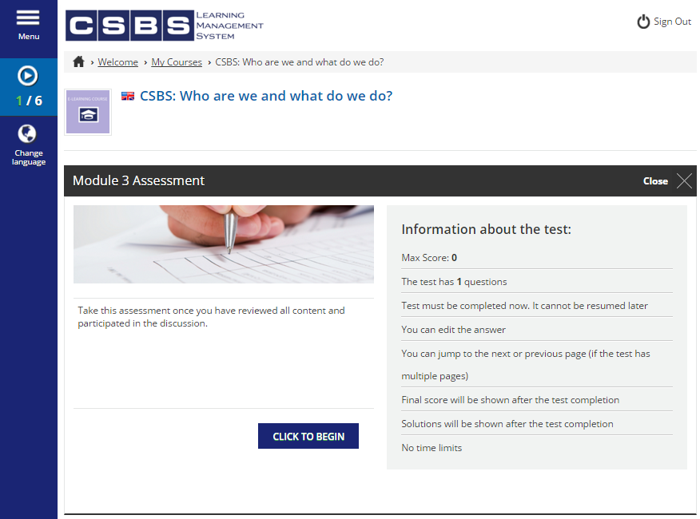
(G6 & G8) The assessment for the module helps the learner and instructor assess the performance and elicits performance from the student.
STORY NOTES:
Here is an example of the homepage for a Module’s assessment functionality.

Slide 45
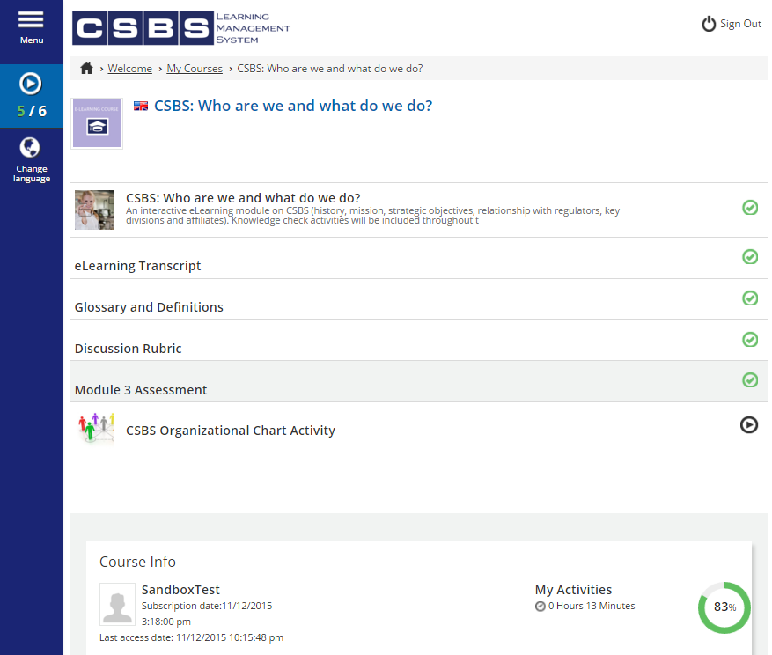
(G6) A detailed and challenging activity elicits performance and keeps the student in the zone of proximal development.
Click
STORY NOTES:
After viewing all of the learning items and passing the assessment, the learner can complete the final activity for the course.

Slide 46
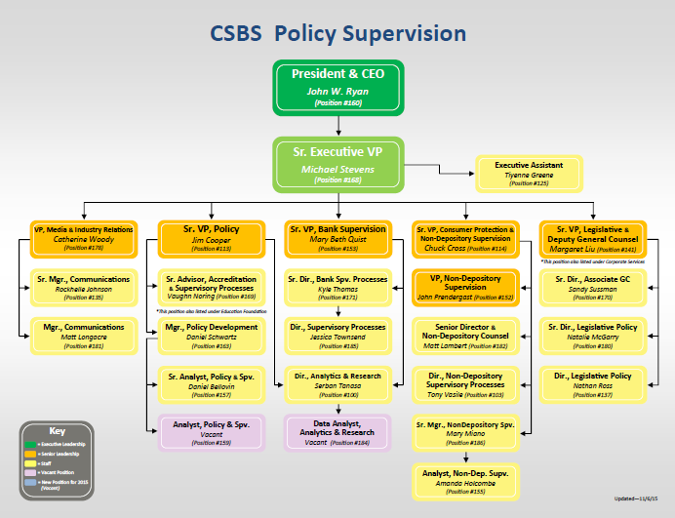
STORY NOTES:
This activity will require the student to complete a partially blank Organizational Chartt

Slide 47
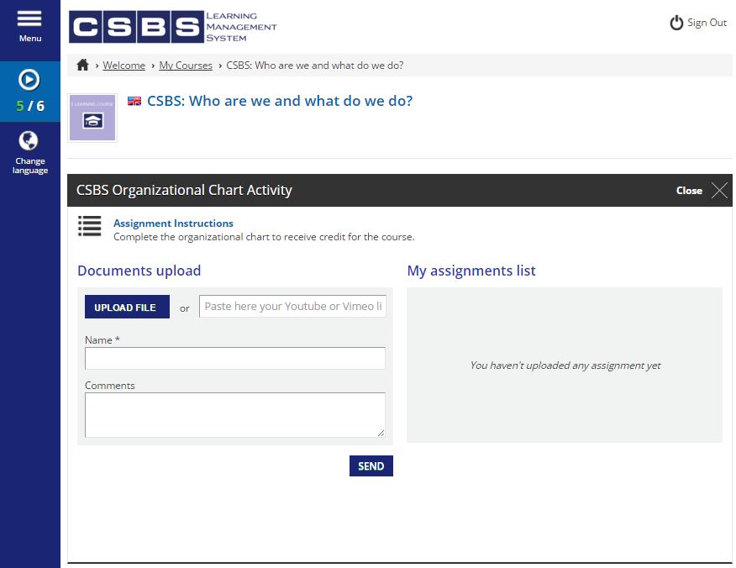
(G6) A detailed and challenging activity elicits performance and keeps the student in the zone of proximal development.
Click
STORY NOTES:
This is the portal through which the student can submit their completed assignment.

Slide 48
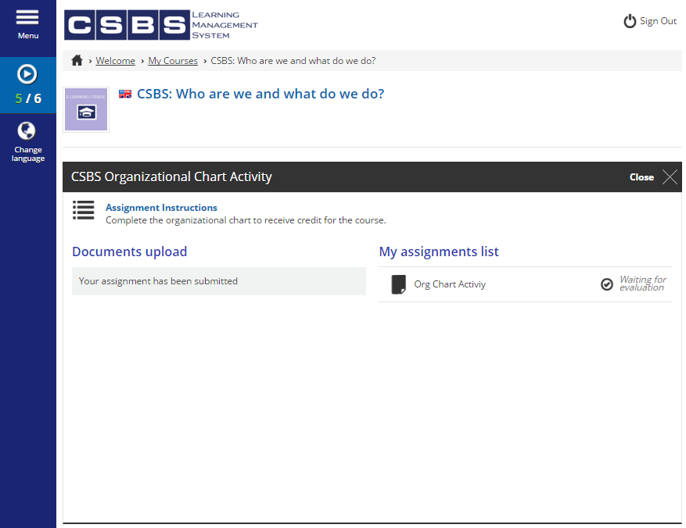
STORY NOTES:
Once submitted, the instructor can go in and evaluate their performance.

Slide 49
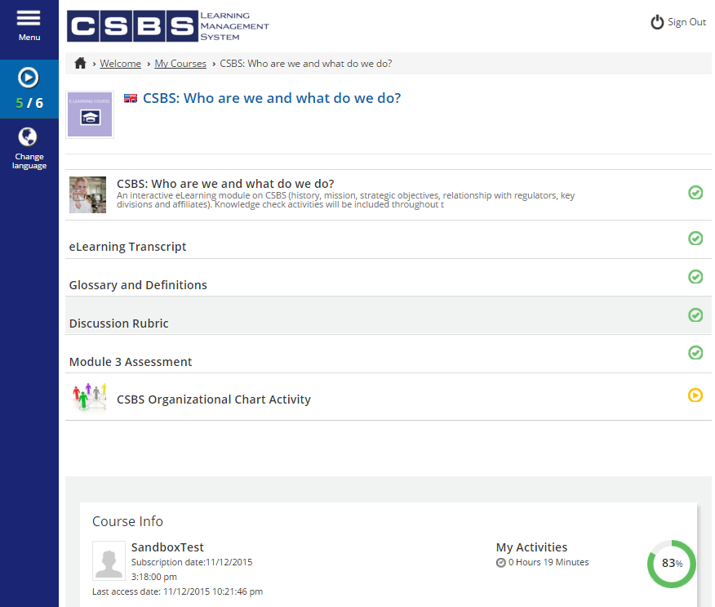
STORY NOTES:
This is the course home page while the student is awaiting evaluation from the instructor.

Slide 50
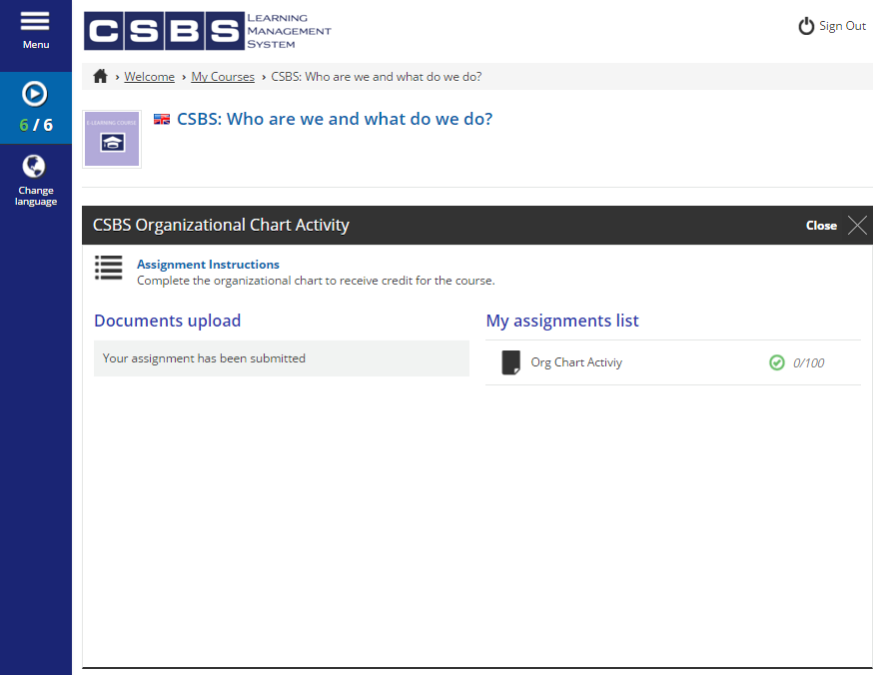
(G7) Student feedback is provided via the LMS. Instructors have the ability to add comments and additional information beyond just the score.
STORY NOTES:
This is what the assignment portal looks like after receiving a passing grade on the final activity.

Slide 51
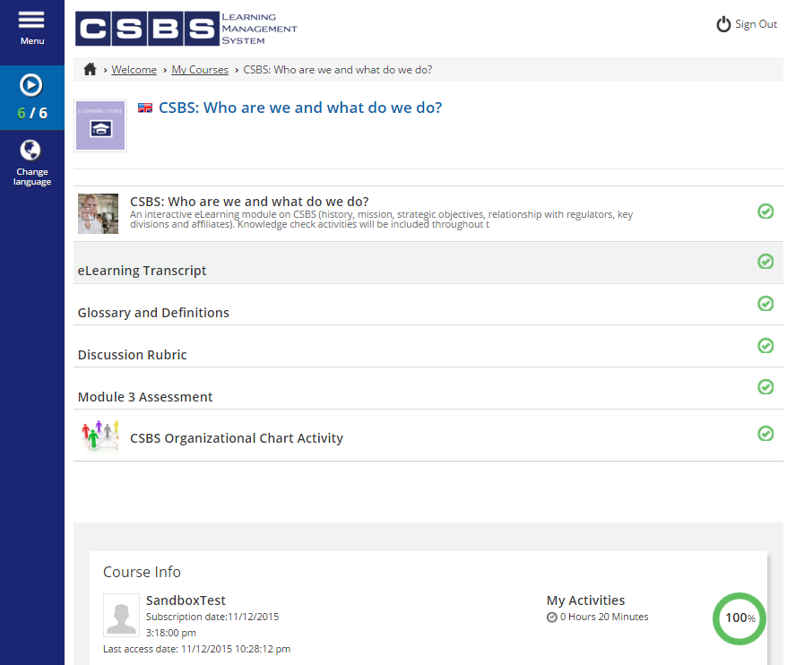
(G7) As the student completes each part of the module, their performance is graded automatically and they are aware of their progress.
STORY NOTES:
Now that the student has completed all learning activities, the course is considered complete.

Slide 52
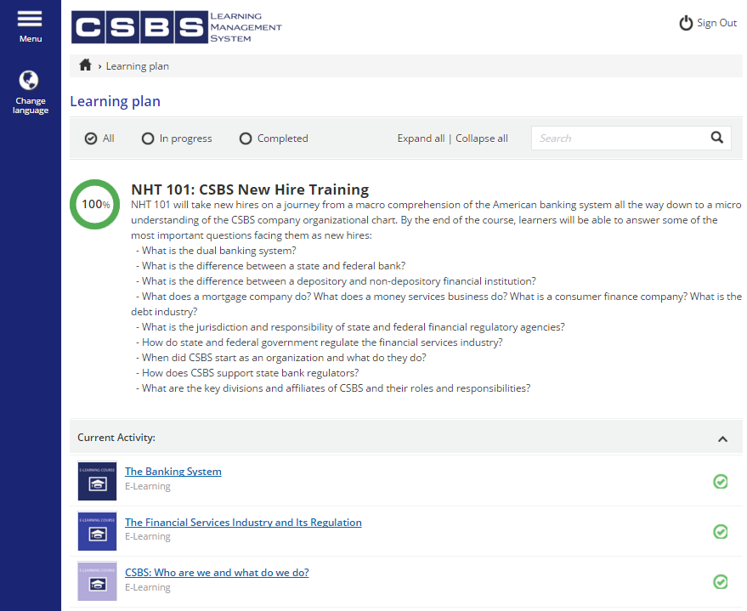
ALL DONE!
STORY NOTES:
This is the final screen for NHT 101, after all objectives have been completed to a satisfactory level.

